Slide 1

Notes:
Chapter 14 Project closure
Chapter 14 is focused on closing a project and a project performance assessment for improving future project management. Specifically, it will focus on project wrap-up, project evaluation, and retrospective review.
Closing a project aims to deliver project deliverables, close project accounts, relocate project staff, close project facilities, and write up a final project report. The effort of project evaluation aims to assess and document project performance. The effort of a retrospective review aims to identify and document lessons learned and best practices. Both project evaluation and retrospective review are geared at systematic learning to accumulate project management expertise and raise project management maturity at the corporate level.

Slide 2
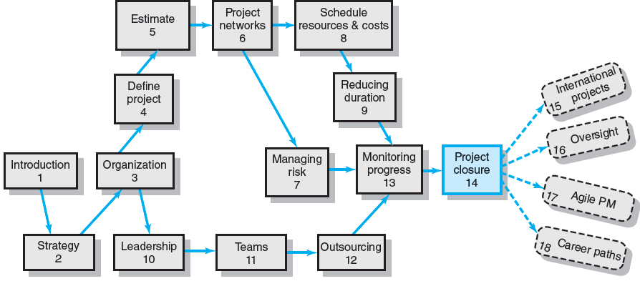
Where We Are Now
Notes:
Where Are We Now?
After the project implementation stage covered in chapter 13, this chapter aims to wrap up the project and review its performance. It also discusses retrospective review of past projects. This is the only chapter that focuses on the closure stage of the project’s life cycle.

Slide 3
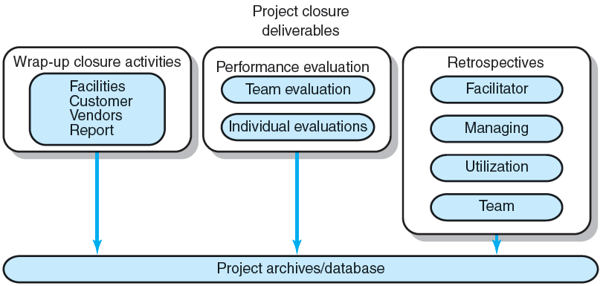
Project closure, performance evaluation, and retrospective review
FIGURE 14.1
Notes:
Project closure, performance evaluation, and retrospective review
Figure 14.1 outlines the three major efforts that usually occur in the closure stage of the project life cycle. They are: project wrap-up, performance evaluation, and retrospective review. The first effort focuses on closing down the project, while the other two focus on an assessment of the project and produce a final report to be kept in the organization’s project archives/database. Each of the three efforts may require many stakeholders to play a role in its process, such as the project manager, team members, project portfolio office, oversight committee, functional managers, and independent retrospective facilitators. In a typical make-to-order company, many projects are carried out in concurrence, leading to many closure and review activities to occur simultaneously. Therefore, each project closure or assessment effort should be planned and implemented like a mini-project. It requires close coordination and cooperation among these stakeholders.

Slide 4
Project Closure
Types of Project Closure
Normal
Premature
Perpetual
Failed Project
Changed Priority
Close-out Plan: Questions to be Asked
What tasks are required to close the project?
Who will be responsible for these tasks?
When will closure begin and end?
How will the project be delivered?
Notes:
Project closure
Project closures can be classified into the following five types.
Normal, which happens when a project is completed normally with successful deliverables. Normally, each engineering project is expected to be a success.
Premature, which occurs when a project is completed early due to elimination of some parts of the project.
Failed project, which happens when a project is completed normally, but without successful delivery.
Changed priority, with which the project was altered or closed. It occurs when the organization changes its strategy, direction or priorities, resulting in no reasons for continuing the project.
Perpetual, where the project can’t reach its final closure. Eventually, it will have to be closed at some point in time, with political will and resolve. A perpetual project usually starts with a great promise but could not deliver at the end.
A project close-out plan needs to be developed, with help by answering the following questions:
What tasks are required to close the project?
Who will be responsible for these tasks?
When will each closure activity begin and end?
How will the project be delivered?

Slide 5
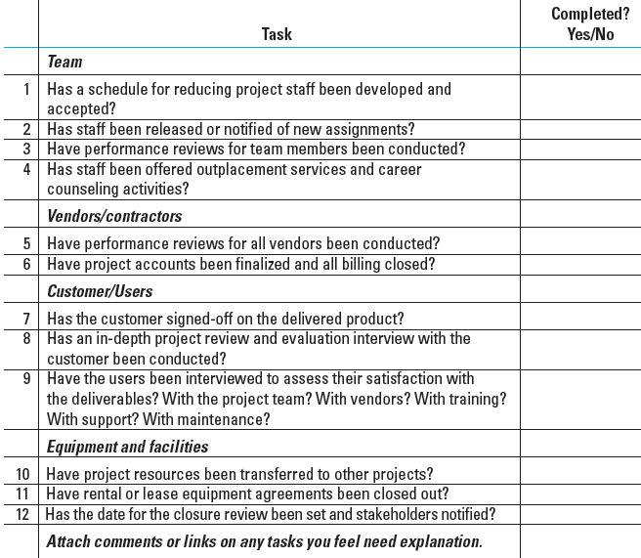
Project Closure Checklist
TABLE 14.1
Notes:
Project closure checklist
Table 14.1 shows a partial checklist of activities for project closing, which helps identify closure activities systematically, from different perspectives of the project team, vendors, customer, and users, among others.

Slide 6
Implementing Project Closure
Getting delivery acceptance from the customer.
Shutting down resources and releasing them to new uses.
Evaluating the team, team members and the project manager; and reassigning project team members.
Closing accounts and paying all bills.
Delivering the project to the customer.
Creating a final report.
Notes:
Implementing Project closure
Many organizations develop a lengthy list of project closure activities as they gain experience. It can be used as a template to ensure nothing is overlooked. Project closure activities can be classified into the six major categories:
Getting deliverables approved by the customer
Shutting down resources and releasing them for new uses.
Evaluating and reassigning project team members.
Closing accounts and making sure all bills are paid.
Delivering the project to the customer.
Creating a final report.

Slide 7
Creating the Final Report
Executive Summary
Project goals met/unmet
Stakeholder satisfaction with project
User reactions to quality of deliverables
Review and Analysis
Project mission and objective
Procedures and systems used
Organization resources used
Recommendations
Technical improvements
Corrective actions
Lessons Learned
Reminders
Retrospectives
Appendix
Backup data
Critical information
Notes:
A final project report is used to summarize project performance. It should have the following sections and topics:
Executive Summary
Project goals met/unmet
Stakeholder satisfaction with project
User reactions to quality of deliverables
Review and Analysis
Project mission and objective
Procedures and systems used
Organization resources used
Recommendations
Technical improvements
Corrective actions
Lessons Learned
Reminders
Retrospectives
Appendix
Backup data
Critical information

Slide 8
Project Performance Evaluations
Reasons for Poor-Quality Project Performance Evaluations:
Evaluations of individuals are left to supervisors of the team member’s home department.
Typically measure team performance only on time, cost, and specifications.
Notes:
Project performance evaluations
Project performance evaluation usually is conducted, after the project is closed down. Often it is done poorly, because of the following two main reasons:
Evaluation of individuals is left to supervisors of the team members’ home (functional) department who are NOT familiar with the team member’s performance and contributions to the project.
Project performance evaluation usually measures only team performance of time, cost and specifications.

Slide 9
Pre-Implementation Conditions: Team
Are standards and goals for measuring performance clear, challenging, and attainable? Lead to positive consequences?
Are responsibilities and performance standards known by all team members?
Are team rewards adequate? Management believes teams are important?
Is there a career path for successful project managers
Does the team have discretionary authority to manage short-term difficulties?
Is there a high level of trust within the organization culture?
Are there criteria beyond time, cost, and specifications?
Notes:
Before an evaluation of the project team can be effective and useful, a minimum core of conditions needs to be in place before the project begins. Some typical conditions are listed here in the form of questions:
Are standards and goals for measuring performance clear, challenging, and attainable? Do they lead to positive consequences?
Are individual responsibilities and performance standards known by all team members?
Are team rewards adequate? Do they send a clear signal that senior management believes that the synergy of teams is important?
Is a clear career path for successful project managers in place?
Is the team empowered to manage short-term difficulties?
Is there a relatively high level of trust emanating from the organizational culture?
Are there evaluation criteria beyond time, cost, and specifications?

Slide 10
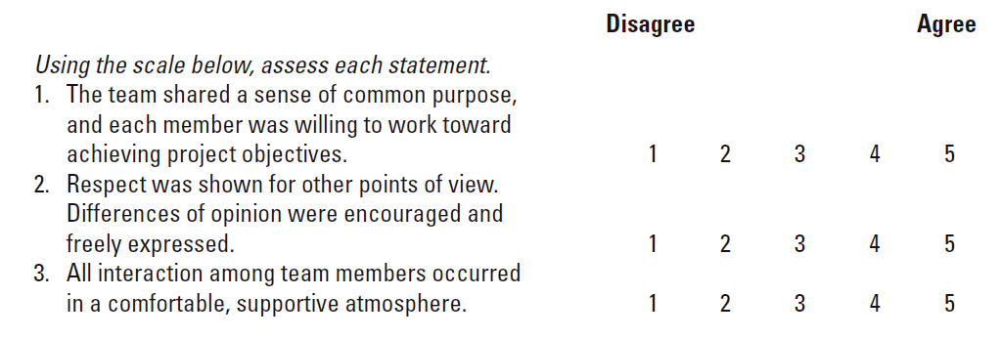
Sample Team Evaluation and Feedback Survey
TABLE 14.2
Notes:
Table 14.2 presents an example of a partial survey that uses a disagree-to-agree scale for its evaluation items. After the results are tabulated, the team meets with the facilitator and/or senior management, and the results are reviewed to assess the development of the team, its strengths and weaknesses, and the lessons that can be applied to future project work.

Slide 11
Project Performance Evaluation: Individual
Performance Assessment Responsibilities:
Functional organization or functional matrix: the individual’s area manager.
The area manager may solicit the project manager’s opinion of the individual’s performance on a specific project.
Balanced matrix: the project manager and the area manager jointly evaluate an individual’s performance.
Project matrix and project organizations: the project manager is responsible for appraising individual performance.
Notes:
Project performance evaluation: individual
The responsibility of evaluating individual’s project performance largely depends on the organizational structure.
In a functional organization, the functional manager of each team member is responsible, though s/he may solicit the project manager’s opinion of the individual’s performance on a specific project task.
In a balanced matrix organization, the project manager and the area (functional) manager jointly evaluate each individual’s performance.
In a projectized organization, the project manager is responsible for appraising individual performance.

Slide 12
Conducting Performance Reviews
Begin by asking the individual to evaluate his or her own performance.
Avoid drawing comparisons with other team members; rather, assess the individual in terms of established standards and expectations.
Focus criticism on specific behaviors rather than on the individual personally.
Be consistent and fair in treatment of all team members.
Treat the review as one point in an ongoing process.
Notes:
Conducting project performance evaluation of individual team members
General tips are given below for conducting a performance review of individual project team members:
Begin by asking the individual to evaluate his or her own performance to reduce the judgmental nature of the assessment.
Avoid drawing comparisons with other team members; instead, assess each individual in terms of established standards and expectations.
Focus criticism on specific behaviors rather than on the individual personally.
Be consistent and fair in treatment of all team members.
View the review as one point in an ongoing process to improve an individual’s performance.

Slide 13
Individual Performance Assessment
Multiple rater appraisal (360-degree feedback)
Involves soliciting feedback concerning team members’ performance from all of the people that their work affects.
Project managers, area managers, peers, subordinates, and customers.
Notes:
Individual performance assessment
The use of multiple rater appraisal (“360-degree feedback) is intended to develop a broad-based view of individual team member’s performance by soliciting feedback on their performance from all people affected by their work, including project managers, area managers, customers, peers, and subordinates.

Slide 14
Retrospective reviews
Lessons Learned
An analysis carried out during and shortly after the project life cycle to capture positive and negative project learning—“what worked and what didn’t?”
Goals of Retrospectives
To reuse learned solutions
To stop repetitive mistakes
Notes:
Retrospective reviews (audits)
Retrospective reviews are intended to learn from past project management experience in order to stop repeating the same mistakes and to improve the performance of project management in the future, by a systematical study of past projects. Retrospective reviews should be viewed as a corporate learning process by analyzing project management experience and answering questions of “what worked and what didn’t? And why?” Most retrospective reviews are carried out shortly after the project’s life cycle, to capture both positive and negative project experience.

Slide 15
Retrospective review
Barriers to Organizational Learning
Lack of post-project time for developing lessons
No post-project direction or support for teams
Lessons become blame sessions
Lessons are not applied in other locations
Organizational culture does not recognize value of learning
Notes:
Barriers to organizational learning
Retrospective reviews are important to corporate learning. However, many companies do not engage in effective corporate learning. Listed below are some of the major barriers to effective organizational learning in the retrospective review process:
Lack of post-project time for developing lessons
No post-project direction or support for teams
Lessons become blame sessions
Lessons are not applied in other locations
Organizational culture does not recognize the value of learning.

Slide 16
The Ways to improve corporate learning
Making Retrospectives Effective:
Use an independent facilitator to guide the project team through the analysis project activities.
Include a minimum of three in-process learning gates during the life project cycle.
Designate a team member as owner for each point in the retrospective.
Develop an easy-to-use learning repository to ensure future utilization of retrospective lessons.
Mandate use of retrospectives as part of the normal process for all projects.
Notes:
Ways to improve organizational learning
There are ways for improving organizational learning and making the retrospective process more effective, such as:
Using an independent facilitator to guide the project team through the project analysis activities.
Including at least three in-process learning gates during the project life cycle.
Designating a team member as owner for each point in the retrospective.
Developing an easy-to-use learning repository to facilitate the use of retrospective lessons.
Mandating the use of retrospectives as part of the normal process for all projects.

Slide 17
Characteristics of an independent facilitator
No direct involvement or direct interest in the project.
Perceived as impartial and fair
Respect of senior management and other project stakeholders.
Willingness to listen.
Independence and authority to report audit results without fear of recriminations from special interests.
Perceived as having the best interests of the organization in making decisions.
Broad-based experience in the organization or industry.
Notes:
Characteristics of an independent facilitator
An effective independent facilitator should have the following characteristics:
Do not have direct involvement or direct interest in the project.
Is perceived as fair and impartial, and being perceived as a person having the best interests of the organization in making decisions.
Is willing to listen.
Is independent with authority to report audit results without fear of recriminations from special interests.
Has respect of senior management and other project stakeholders.
Has broad-based experience in the organization or industry.

Slide 18
Initiating the Retrospective Review
Have automatic times or points when audits will take place. Avoid surprises.
Conduct audits carefully and with sensitivity.
Audit staff must independent from the project.
Audit reports need to be used and accessible.
Audits support organizational culture.
Project closures should be planned and orderly.
Certain “core conditions” must be in place to support team and individual evaluation.
Conduct individual and team evaluations separate from pay or merit reviews.
Notes:
Initiating a retrospective review (audit)
Initiating a retrospective review in an organization should be a routine (normal) process, based on the following considerations:
Automatically trigger a retrospective review at a specific time or point in the project life cycle. Avoid surprises.
Conduct review carefully and with sensitivity.
Review staff must be independent from the project.
Review reports need to be accessible and useful.
Organizational culture supports the review.
It needs to be well planned and conducted in orderly fashion.
Need to make sure that certain “core conditions” are in place to support team and individual evaluation.
Individual and team evaluations should be separated from pay/merit reviews.

Slide 19
The retrospective review process
Initiation and staffing
Data collection and analysis
Reporting
Notes:
The retrospective review process
A retrospective review can be viewed and planned as a mini-project. It consists of the following three steps
Initiation and staffing
Data collection and analysis
Reporting of lessons learned and findings

Slide 20
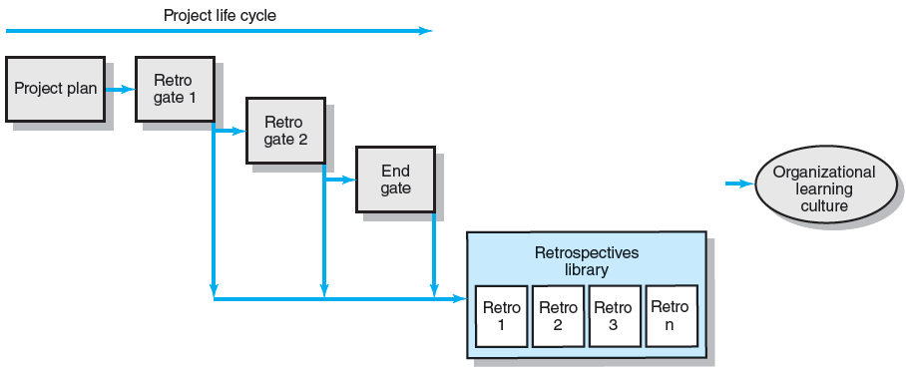
The Retrospectives Process
FIGURE 14.2
Notes:
Incorporating retro gates in the project plan
In an organization with strong learning culture, interim retrospective gates may be planned and included in the project plan and carried out as part of planned in-project activities. Figure 14.2 shows a project plan that has three interim retrospectives built in its work flow to gather lessons learned during its project’s life cycle and then store them in a corporate database for sharing and reuse.

Slide 21
Retrospective Project Review Questionnaire
Were the project objectives and strategic intent of the project clearly and explicitly communicated?
Were the objectives and strategy in alignment?
Were the stakeholders identified and included in the planning?
Were project resources adequate for this project?
Were people with the right skill sets assigned to this project?
Were time estimates reasonable and achievable?
Were the risks for the project appropriately identified and assessed before the project started?
Were the processes and practices appropriate for this type of project? Should projects of similar size and type use these systems? Why/why not?
Did outside contractors perform as expected? Explain.
Were communication methods appropriate and adequate among all stakeholders? Explain.
Is the customer satisfied with the project product?
Are the customers using the project deliverables as intended? Are they satisfied?
Were the project objectives met?
Are the stakeholders satisfied their strategic intents have been met?
Has the customer or sponsor accepted a formal statement that the terms of the project charter and scope have been met?
Were schedule, budget, and scope standards met?
Is there any one important area that needs to be reviewed and improved upon? Can you identify the cause?
TABLE 14.3
Notes:
Project review questionnaire
Table 14.3 lists typical questions to be used in a project retrospective review questionnaire, which is typically distributed to all significant project stakeholders for responses.

Slide 22
Organizational Culture Review Questionnaire
Was the organizational culture supportive for this type of project?
Was senior management support adequate?
Were people with the right skills assigned to this project?
Did the project office help or hinder management of the project? Explain.
Did the team have access to organizational resources (people, funds, equipment)?
Was training for this project adequate? Explain.
Were lessons learned from earlier projects useful? Why? Where?
Did the project have a clear link to organizational objectives? Explain.
Was project staff properly reassigned?
Was the Human Resources Office helpful in finding new assignments? Comment.
TABLE 14.4
Notes:
Organizational culture review questionnaire
It is important to also audit the organizational culture in the retrospective review. Table 14.4 lists questions to be considered for questionnaire surveying organizational culture. They aim to assess major properties of the organization’s culture that could affect project success and failure, or could become a hindrance to project teams.

Slide 23
Archiving Retrospectives
Classifying of Projects:
Project type
Size
Staffing
Technology level
Strategic or support
Issues and problems
Project mission and objectives
Procedures and systems used
Organization resources used
Notes:
Archiving retrospectives
The main purpose of retrospective audits is to systematically crystalize project management experience into lessons learned and best practices, so as to enhance the company’s competence and thus its competitive edge in project management. Therefore, it is critical to have a repository system design that will facilitate and promote the use of these lessons learned and best practices. Listed here are attributes commonly used to sort and search projects and project management expertise stored in the project archives.

Slide 24
Key Terms
Lessons learned
Performance review
Project closure
Project evaluation
Project facilitator
Retrospective
Team evaluation
360-degree review
Notes:
Summarized below are some key terminology covered in this chapter, including project closure, performance review, retrospective review, project facilitator, and lessons learned:
Lessons learned are used to improve the management of future projects
Performance review encompasses all review methods of individual performance that center on the technical and social skills brought to the project and team.
Project closure involves all of the major activities of shutting down a project: evaluation of project goals and performance, developing lessons learned, releasing resources, and preparing a final report.
Project evaluation is the process of assessing, verifying, and documenting project results.
Project facilitator is a guide who leads the project team through an analysis of project activities that went well, what needs improvement, and development of a follow-up action plan with goals and accountability.
Retrospective is an effort that analyzes a past project to determine what worked and what didn’t, develops lessons learned, and creates an action plan that ensures lessons learned are used to improve management of future projects.
Team evaluation is the process of evaluating the performance of the project team using a minimum core of initial conditions that emphasizes the team as a whole, while minimizing individual performance.
360-degree review is a multi-rater appraisal system based on performance information that is gathered from multiple sources (superiors, peers, subordinates, customers).

